Slide 1
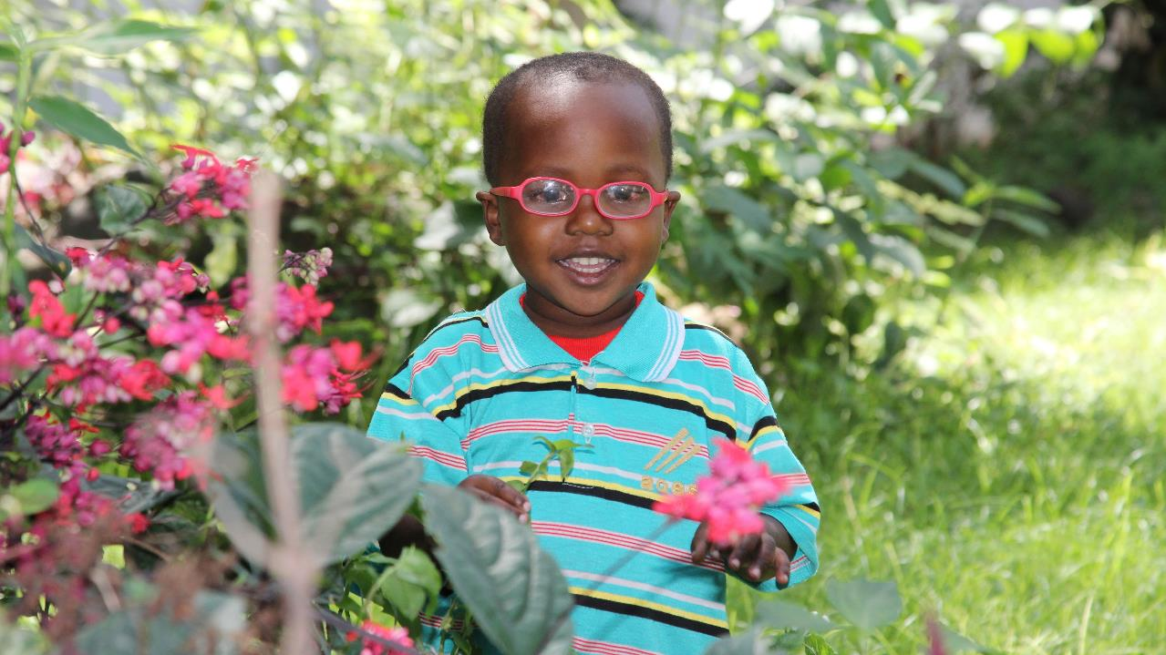
Christian Blind Mission Sunday
Notes:
Note to users:
This presentation for Christian Blind Mission Sunday is designed to be flexible so you can adapt it to your needs and the time you have available.
The full presentation is as follows:
Slides 1-2: Introduction
Slides 3-6: Hemedi’s story
Slides 7-11: Mathias’s story
Slides 12-13: CBM’s solutions
Slides 14-16: About CBM
Slides 18-19: How we can help
Slide 20: Thank you
For a shorter presentation, you could choose to use only one of the stories, and to omit the ‘About CBM’ section. Each page has a script for you to read as you show the slide.

Slide 2
Christian Blind Mission
CBM works in the world’s poorest places to prevent blindness, improve health and transform the lives of people with disabilities.
For more than 110 years, since our founder Ernst Christoffel started working with children with disabilities in Turkey and Iran, we’ve been reaching out to those whom others leave behind.
Driven by Christian values, we work with disabled people to break down barriers by delivering practical support, improving policy and practice and inspiring the people of the UK to act.

Slide 3
Blindness and poverty - a vicious cycle
If you live in poverty you are much more likely to lose your sight. Nearly 90% of visually impaired people live in low and middle-income countries.
Poor nutrition and living conditions mean higher risk of eye diseases, while treatment for blinding conditions is often out of reach.
There is a vicious cycle of poverty and blindness. And we’re out to break it.

Slide 4
Nobody should become blind simply because the are poor
With your help, we can prevent blindness and restore sight in the world’s poorest places by:
improving access to sight-saving eye treatments, including sight-restoring cataract surgery and treatment for blinding diseases like glaucoma
helping eliminate blinding diseases like river blindness and trachoma that blight some of the world’s poorest communities.
supporting screening programmes that identify people with eye conditions and enable them to access treatment before it’s too late.
ensuring people with low-vision can access glasses, braille, canes and support, so they can go to school, earn a living and be active in their communities.
training specialist doctors, nurses and other health workers to identify and treat eye conditions and equipping hospital eye departments, especially in rural areas, so that people can access treatment nearer to their home.
working with Governments and health authorities to support and equip them to strengthen eye health services for the long-term.

Slide 5
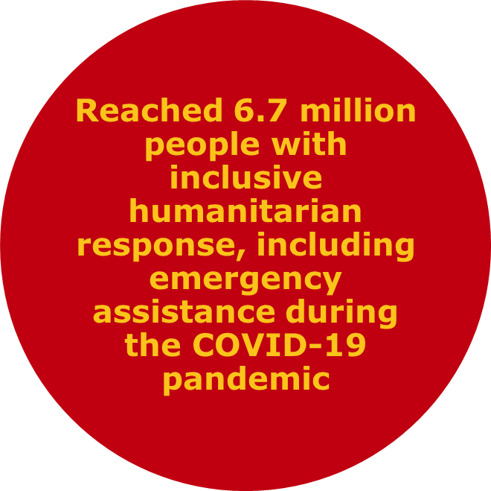
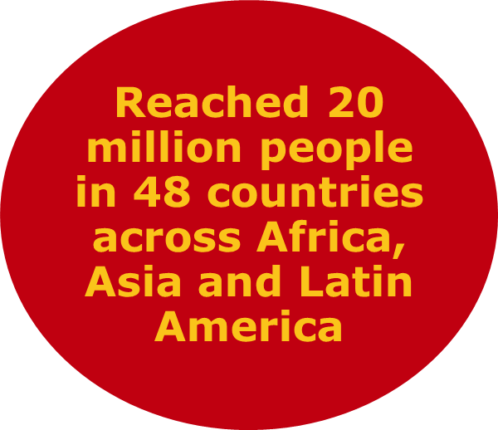
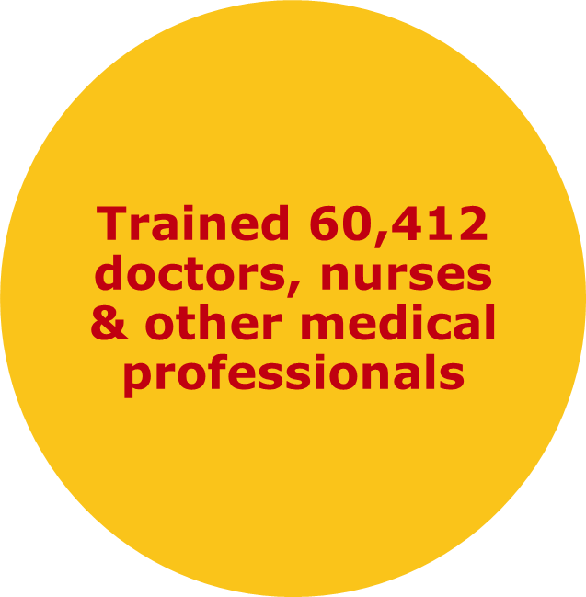
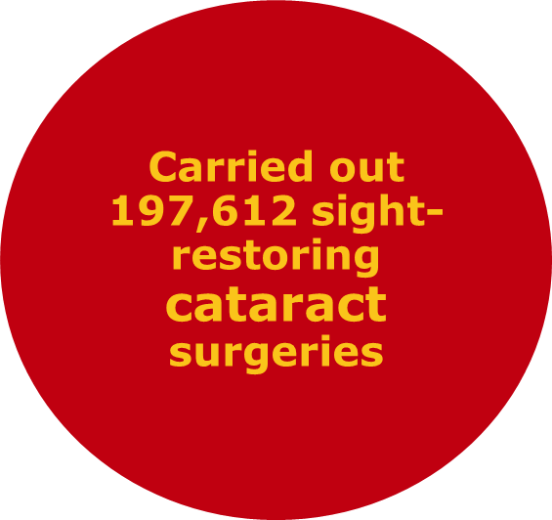
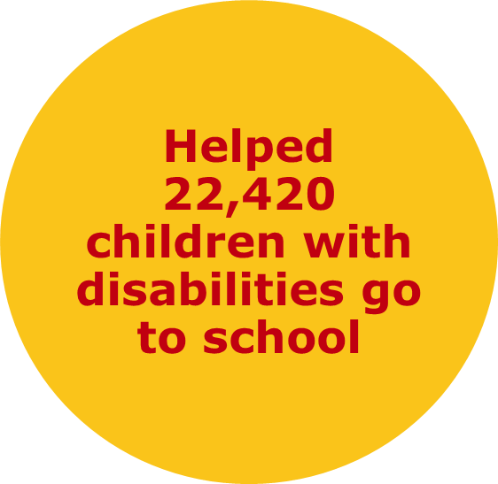
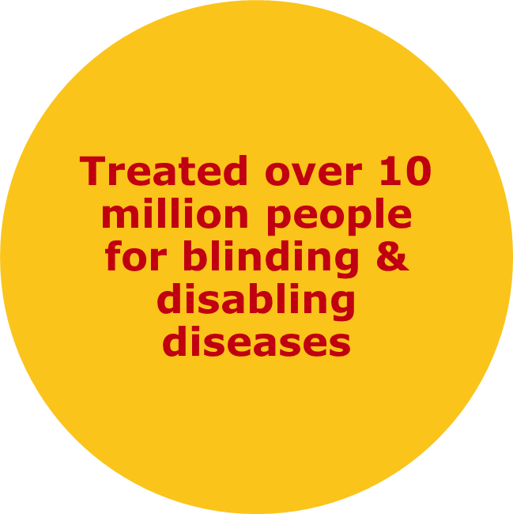
Key statistics
In 2020, CBM and our partners:

Slide 6
How you can help
Every year, supporters like you help us protect millions of people from blinding diseases, deliver hundreds of thousands of sight-saving cataract surgeries, and provide over half a million pairs of glasses and devices to improve sight. You can help make it possible for people living in the poorest and most remote communities to receive proper eye care.
You can ensure that nobody is left behind because of visual impairment today.
£1 could buy a Snellen eye chart to help diagnose people with visual impairments.
£39 could pay for a pair of glasses to open up the world for someone with poor vision.
£99 could fund a two-day training course for a Community Rehabilitation Worker, helping them to identify people with cataracts and other visual impairments.
£100 could train a teacher on how to help children who struggle to see.
£183 could transform the lives of 10 children who need glasses or other low vision aids to correct their sight after surgery.
£350 could train specialist eye surgeons in the world’s poorest places so they can restore sight to hundreds of people for years to come.

Slide 7
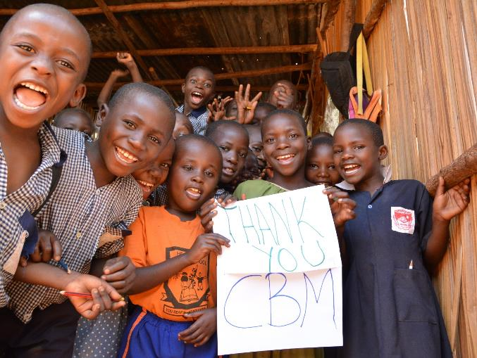
Thank you for listening
www.cbmuk.org.uk
@cbmuk.org
@CBMuk
CBM_UK
CBM UK
Notes:
This is only possible thanks to the support of people like us.

